Slide 1


GitHub Copilot
Gitanjali Patil

Slide 2
What is GitHub Copilot?
Cloud based Generative AI tool.
Developed by Microsoft in collaboration with OpenAI, GitHub Copilot is powered by OpenAI Codex.
AI pair programmer.
Works across multiple programming languages.
Works on multiple IDE.

Slide 3
How GitHub Copilot works?

Slide 4
GitHub Copilot Features
A ChatGPT-like experience in your editor with GitHub Copilot Chat
Copilot for the command line interface (CLI)
Convert comments to code
Autofill repetitive code
Show alternatives

Slide 5
Copilot for Business: Security and Privacy
Does NOT retain user content (e.g. code from user's editor)
Does NOT use your code to Improve the model
Does NOT retain suggestions produced by Copilot
Does NOT send information to OpenAI, the software company

Slide 6
Triggering GitHub Copilot
Inline Suggestions
Command Palette
Copilot Chat
Inline Chat
Comments to Code
Multiple Suggestions
Explain This Code
Generate Unit Tests

Slide 7
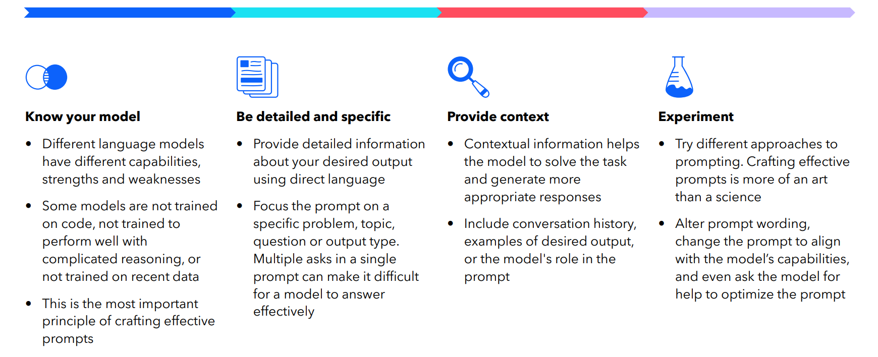
The Power of Prompt Engineering

Slide 8
GitHub Copilot demo

Slide 9
Thank you!

